Slide 1

IST 718 Final Project
Team 4
Brandon Bergstrom
Mark R Paradis
Charles Vanleuvan
George Smith

Slide 2
Project Update One Summary
Specification
The “problem” our group is trying to solve is to create a model that is can be used to produce predictions of fight wins in order to create a second source of income for our team
Observation
Typical sports betting prediction is usually 5-10% better than flipping a coin, we need to aim to get our model to predict higher than this in order to consider our model strategy profitable
Analysis
We started to identify the essential predictive features of our model. Many of the features surrounding strikes and attempts to ground the opponent and the importance of lower body strikes
Recommendation
Once we have finalized our model, utilizing the fight data has produced well performing models but including other feature such as money line odds may be the key to giving our model the edge over standard betting odds.
Data Understanding | Preprocessing | Analysis | Testing | Communicating Results
5% of time / 4 people | 10% of time / 4 people | 40% of time / 4 people | 40% of time / 4 people | 5 % of time / 4 people

Slide 3
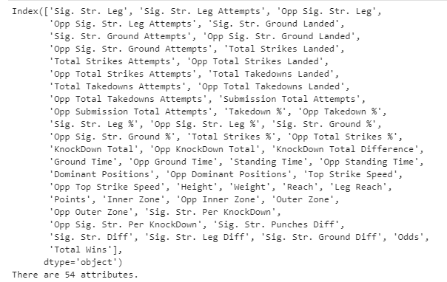
Observe
54 Attributes

Slide 4
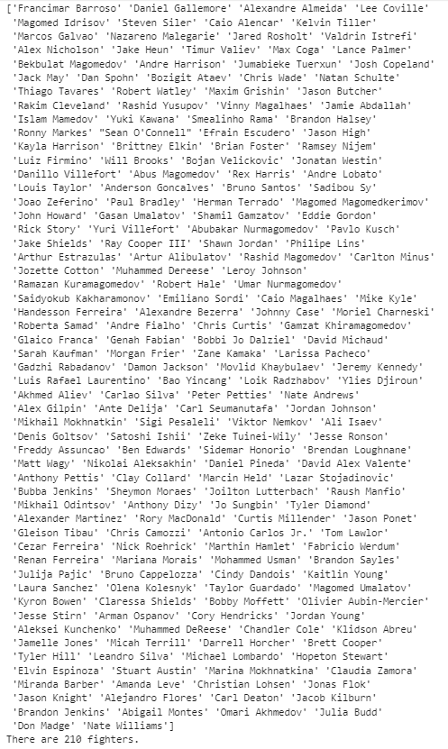
Observe
210 Fighters

Slide 5
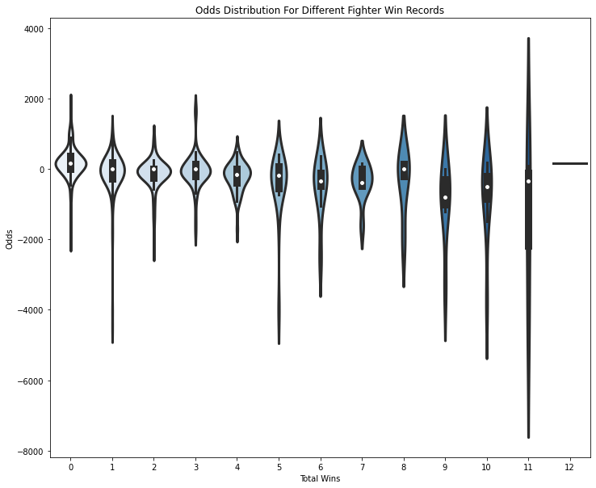
Analysis

Slide 6
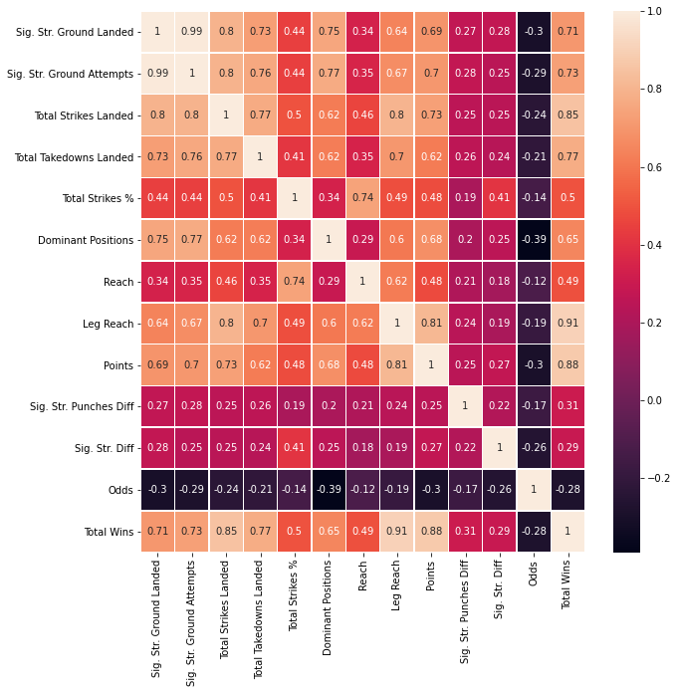
Analysis

Slide 7
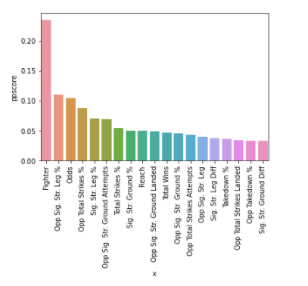
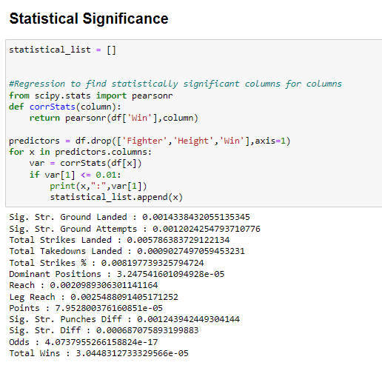
Analysis

Slide 8
Recommendation Next Steps
Model Selection and Tuning
TensorFlow
Random Forest
Keras CNN

